Slide 1
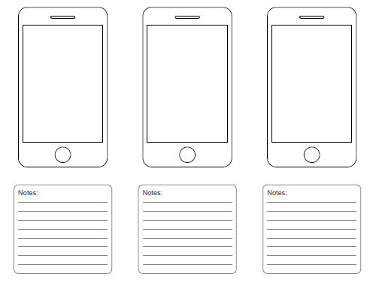
Thank you for recycling
You’re amazing!

Slide 2
Thank you for recycling
You’ve received a % discount

Slide 3
Thank you for recycling
You’ve received £

Slide 4
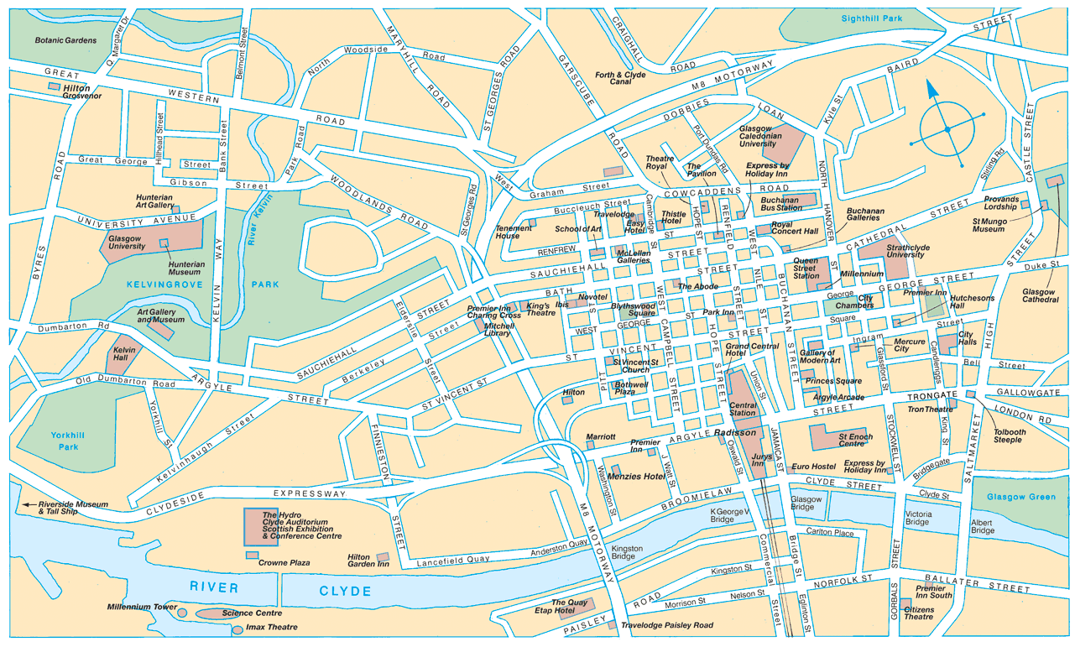

Slide 5
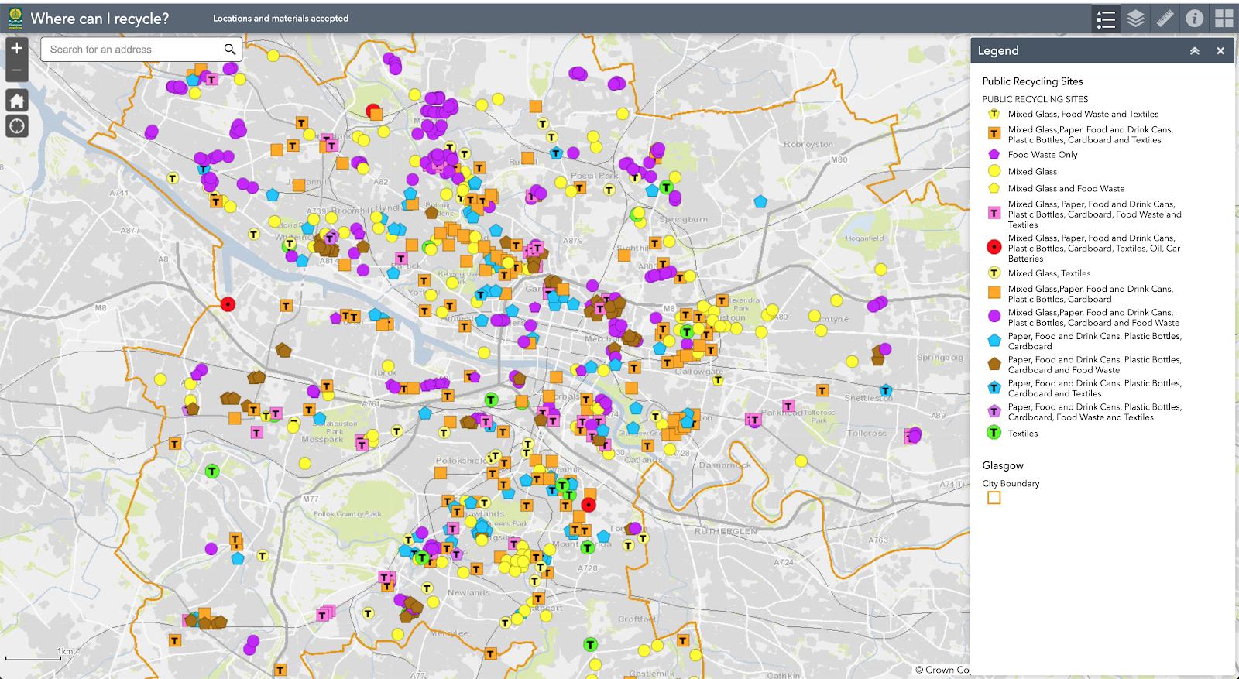

Slide 6


Take a photo
Scan a barcode
What material is this? (dropdown)
Describe the item
What weight is it?

Slide 7
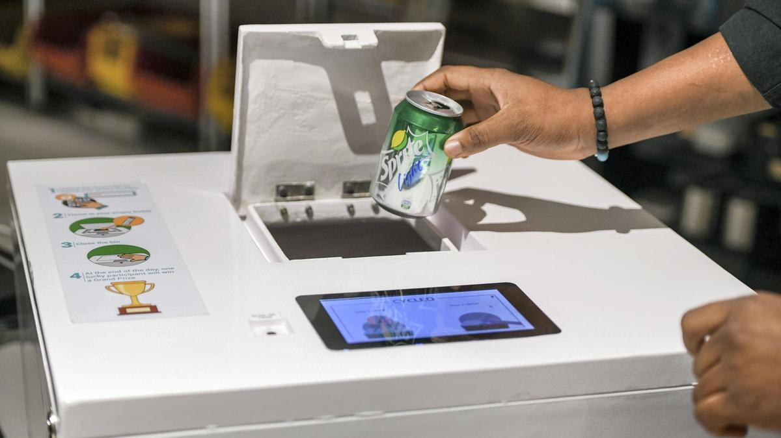

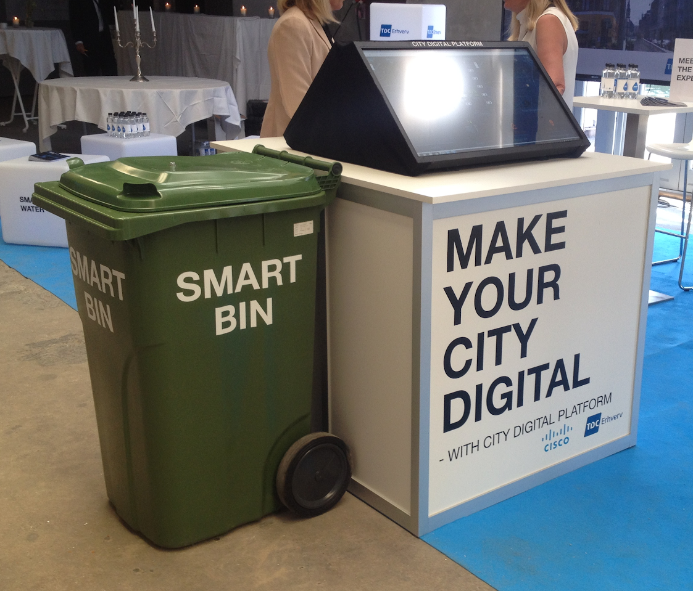
Drop-off confirmed
Drop-off point: DHJE372
Location: Buchanan Street
Time: 3.00pm 4 June 2020
Thank you!
You have earned +10 rewards
Your balance is: 1000 rewards

